Slide 1
Demystifying Data Compression
Andy Mallon

Slide 2
Who is Oliver Smoot?
Oliver R Smoot
MIT Class of 1962
Former Chairman of American National Standards Institute (ANSI)
Former President of International Organization for Standardization (ISO)
smoot
An ANSI unit of measure equal to 5-feet, 7-inches
Listed in American Heritage Dictionary
Harvard Bridge (Mass Ave Bridge) is 364.4 smoots + 1 ear
Notes:
As a fraternity pledge for Lambda Chi Alpha, he was the shortest pledge at 5-foot 7-inches. The pledges were instructed to take their shortest member and in the cover of night, measure the length of the Mass Ave Bridge, which spans from Cambridge (where MIT is) to Boston. They were to mark the distance on the bridge with paint, and report back with the exact measurement. To this day, pledges re-paint the bridge every year to mark the distance in smoots. When the bridge was rebuilt in the late 1980s, the expansion joints were specifically engineered to be 1-smoot long.

Slide 3
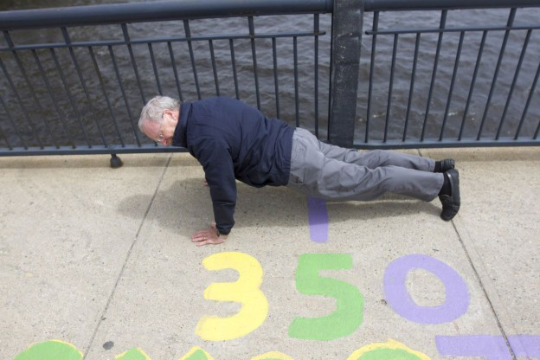
Demo
Photo by Joe Difazio for WBUR

Slide 4
You might be asking…
Andy,
Why the *&$# are you telling this story?
Notes:
Compression is something you should think about. It’s relatively easy to change. But if you think about it up-front, you can save yourself some headaches down the road.

Slide 5
Smoot Wisdom
"Things that you pay no attention to at the time can have big consequences." ~Oliver Smoot Interview with Radio Boston, WBUR, May 6, 2016 http://radioboston.wbur.org/2016/05/06/ollie-smoot-the-official-unit-of-measure-for-the-harvard-bridge

Slide 6
Demystifying Data Compression
Andy Mallon

Slide 7
Andy Mallon
Working with SQL Server since 2003 and SQL Server 2000
Background in Tech Support
Managed databases in many industries
Lazy
Impatient
Healthcare
Finance
E-Commerce
Non-Profit

Slide 8








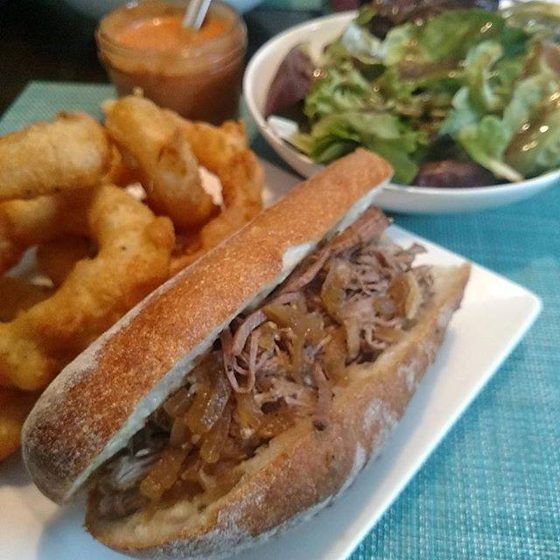



Notes:
Some of the things I love most in life– My husband, my pups, my food (I love to cook), and my city.

Slide 9
SQLSaturday.com/694
December 9th
Bryant College
Smithfield, RI
Full-day Pre-con Dec 8
Data Science with R from A to Z
$150
$120 with code Microsoft
r_programming.Eventbrite.com

Slide 10


Community Ambassador

Slide 11




Contact Info
andy@am2.co
@AMtwo
www.am2.co
linkedin.com/in/AMtwo
@AMtwo
www.am2.co
andy@am2.co

Slide 12

Who uses Twitter?
Where the SQL Community hangs out
#sqlhelp
Free real-time help
Notes:
Who doesn’t want free advice from Brent Ozar or Aaron Bertrand?

Slide 13

Who uses Slack?
If nvarchar(280) isn’t enough
#sqlhelp #powershellhelp #ssrshelp
http://www.dbatools.io/slack for details
Notes:
Who doesn’t want free advice from Brent Ozar or Aaron Bertrand?

Slide 14

Session Feedback
Tell me what you don’t like
Tell me what can be better
Tell me what you like

Slide 15

I'm also gonna need you to go ahead and silence your cell phones
Yea…….You apparently didn’t put one of the new coversheets on your TPS reports.

Slide 16
Agenda
Indexes and Heaps: A quick review (or introduction)
What is data compression?
Differences between the types of data compression
Costs & Benefits
Explore compression algorithms
Practical examples

Slide 17
What we won’t cover
Columnstore indexes
XML indexes
Backup compression
COMPRESS() function
There is an example in the scripts I’ll share
Notes:
We won’t cover every demo script I have—we’ll cover a few, and I’ll give you the rest to explore on your own.

Slide 18
Before I start…
Who has used data compression?
What’s been your experience?
What do you want to learn today?

Slide 19
Indexes and Heaps: A quick review
What is data compression?
Differences between the types of data compression
Costs & Benefits
How does it work?
When does it work?

Slide 20
A quick review (or introduction)
All data is stored on pages
Pages are combined into different structures
B+ Trees
Clustered indexes
Nonclustered indexes
Indexed views
Heaps

Slide 21
Table Structures: B+ Trees
AK
ID
Root Page
Intermediate Level(s)
AK
CA
FL
ID
KY
ME
Leaf Pages
AK AL AR AZ
CA
CO
CT
DE
FL GA
HI
IA
ID
IL
IN
KS
KY
LA
MA
MD
ME
MI MN
MO
Notes:
These are the pages we’re talking about when we talk compression.
Only the LEAF PAGES get compressed in a B Tree Index Everything is ordered. It’s easy to find by traversing the tree. You can find any row in just 3 reads. EXAMPLE: MAINE

Slide 22
Table Structures: Heaps
MA MN IL KY
AR
CO
MI
DE
IN GA
HI
AZ
ID
CT
MD
KS
IA
LA
MO
CA
ME
AK AL
FL
Notes:
It’s unordered. It’s harder to find the row you want. But for our purposes today, it’s similar to the leaf level of a B-Tree

Slide 23
What is data compression?
Indexes and Heaps: A quick review
Differences between the types of data compression
Costs & Benefits
Explore compression algorithms
Practical examples

Slide 24
What is data compression?
A different method of storing data on disk and in memory
More efficient use of space
Requires slightly more CPU to read/write data
Available in SQL Server 2008 and newer
Enterprise Edition feature
Available in all editions starting with SQL 2016 SP1+
Available in all service tiers of Azure SQL Db
Notes:
Query engine reads from memory.
If the page isn’t in memory, it’s read from disk into memory…. Then the query engine reads from memory.
Regardless, the page is compressed (or not compressed) the same in memory and on disk
Starting in 2016 SP1, compression is available in all editions. Note, you can start compression indexes in Standard or Enterprise Edition, but note that its still not an ONLINE operation unless you’re on Enterprise

Slide 25
Differences between types
Indexes and Heaps: A quick review
What is data compression?
Costs & Benefits
Explore compression algorithms
Practical examples

Slide 26
Compression types
ROW
PAGE
Applied to each individual row
Usually makes a row occupy fewer bytes
Smaller rows → More rows per page
Applies row compression first
Then prefix compression
Then dictionary compression
Essentially dedupes data within the page
Notes:
Notice I say USUALLY takes less space. It’s that whole “It Depends” thing. More on that later

Slide 27
Syntax
WITH (Data_Compression=[NONE/ROW/PAGE])
CREATE TABLE
CREATE INDEX
ALTER TABLE…REBUILD
ALTER INDEX…REBUILD
Anytime you build/rebuild an entire B-Tree or table

Slide 28
Useful stored procedures & DMVs
sp_helpindex isn’t helpful
sp_BlitzIndex from Brent Ozar Unlimited
sp_helpindex variants from SQL Skills
sp_estimate_data_compression_savings
sys.dm_db_index_physical_stats

Slide 29
Costs & Benefits
Indexes and Heaps: A quick review
What is data compression?
Differences between the types of data compression
Explore compression algorithms
Practical examples

Slide 30
Costs & Benefits
Pros
Cons
Less space on disk
This benefit multiplies each time you copy data to a different environment
More rows per page on disk
Fewer physical IO operations
More rows per page in memory
Cache more data in memory
Fewer logical IO operations
Small CPU overhead associated with compression
Is CPU already a bottleneck?
Overall CPU impact likely minimal
Data needs to decompressed every time you read a page from memory
Enterprise Edition feature (until 2016)
$$$$
Impacts database portability
Notes:
Because it’s the SAME PAGE on memory & on disk, these two bullets are really saying the same thing No longer Enterprise only if (only if) you are on 2016 SP1+ The list of cons is pretty short.

Slide 31
Disk is not cheap
Your database server probably uses the most expensive storage in your data center
Enterprise SAN storage is $5k-8k per usable TB
Environment | Size on disk | Storage cost
Production | 10 TB | $80,000
UAT/Staging | 10 TB | $50,000
QA | 10 TB | $50,000
Development | 10 TB | $50,000
 | 40 TB | $230,000
Notes:
I stress USABLE TB. Enterprise SAN uses hot spares, RAID 10

Slide 32
Disk is not cheap
Are you using Availability Groups?
Do you have a DR site?
Reporting Environment?
What about backups?
Weekly, Monthly, Yearly retention
Environment | Size on disk | Storage cost
Production | 10 TB | $80,000
Prod AG Secondary | 10 TB | $80,000
Prod DR site | 10 TB | $80,000
Reporting | 10 TB | $60,000
UAT/Staging | 10 TB | $50,000
UAT AG Secondary | 10 TB | $50,000
QA | 10 TB | $50,000
Development | 10 TB | $50,000
Backups
 | 80 TB | $500,000+
Notes:
If you can make your database require less disk space, you can save LOTS of money. If you go to your CIO and say “I can save you $100,000 in storage costs.” You’ll look REALLY good.

Slide 33

SAN
SAN Admins
DBAs
Notes:
Not sure what the power pellets are…. Business Requirements?

Slide 34
Explore compression algorithms
Indexes and Heaps: A quick review
What is data compression?
Differences between the types of data compression
Costs & Benefits
Practical examples

Slide 35
Uncompressed Index (from Flour cookbook by Joanne Chang)
Addictive Bran Muffins with Golden Raisins and “Bird Seed” 58-59
Almond and Anise Biscotti 128-129
Almond-Apricot Muffins 54
Almond Macaroons with Bittersweet Chocolate Ganache 130-132
Almond Craquline 82-83
Almond Frangipane 239
Almond-Hazelnut Dacquoise 196-199
Almond Meringue Clouds 126-127
Almond Mixed Nut Brittle 284-285
Almond Granola 101
Almond Ooey, Gooey Caramel-Nut Tart 228-229
Almond Roasted Pear and Cranberry Crostata 237-239
Almond roasting 34
Notes:
Its easy to read. Notice it goes up to “Almond roasting” then we run out of room on the page

Slide 36
ROW compression simplified
Treats certain fixed-length datatypes as variable-length
Removes some metadata to save overhead
Storage of NULL and 0 values is optimized
R O W D A T A
ROW DATA
Notes:
ROW compression squishes the data by removing extra space.

Slide 37
Row-Compressed Index (from Flour cookbook by Joanne Chang)
Addictive Bran Muffins with Golden Raisins and “Bird Seed” – 58-59;
Almond and Anise Biscotti - 128-129; Almond-Apricot Muffins – 54;
Almond Macaroons with Bittersweet Chocolate Ganache - 130-132;
Almond Craquline - 82-83; Almond Frangipane – 239; Almond-Hazelnut Dacquoise - 196-199;
Almond Merengue Clouds - 126-127; Almond Mixed Nut Brittle 284-285;
Almond Granola – 101; Almond Ooey, Gooey Caramel-Nut Tart - 228-229;
Almond Roasted Pear and Cranberry Crostata - 237-239; Almond roasting – 34;
Angel Food Cake with Toasted Coconut – 178-179; Apple and Quince Tarte Tatin – 233-235;
Apple, Cinnamon, and Brown Sugar Filling – 90; Apple Snacking Spice Cake – 64-65;
Apple-Raisin Charlottes with Vanilla Caramel Sauce – 272-273;
Double Two-Apple Pie – 203-205; Apple Good Morning Muffins – 60-61;
Apple Granola Bars – 154-156; Apple Heart-Healthy Dried Fruit Scones – 50-51;
Apple Homemade Pop-Tarts – 88-91; Bacon and Caramelized Onion Quiche – 241;
Notes:
See? I removed extra space, an fit even more stuff on the page! We made it all the way to Bacon! The added cost is that it’s a bit harder to read. I have to think a little bit harder to read the data.

Slide 38
PAGE compression simplified
Does ROW compression FIRST
Dedupes repetitive values between rows
Prefix Compression
Dictionary Compression
Notes:
A PAGE compressed index could have some pages that are not page-compressed

Slide 39
PAGE compression simplified
R O W D A T A
R O W D A T A
R O W D A T A
R O W D A T A
ROW DATA
ROW DATA
ROW DATA
ROW DATA
ROW DATA x 4

Slide 40
Page-Compressed Index (from Flour cookbook by Joanne Chang)
[Almond]{nut}{Granola}{Caramel}{Apple}{Baking}{Banana}{Bread}{Muffins}
Addictive Bran Muffins with Golden Raisins and “Bird Seed” – 58-59; [1] and Anise
Biscotti - 128-129; [1]-Apricot {9} – 54; [1] Macaroons with Bittersweet Chocolate
Ganache - 130-132; [1] Craquline - 82-83; [1] Frangipane – 239; [1]-Hazel{2}
Dacquoise - 196-199; [1] Meringue Clouds - 126-127; [1] Mixed Nut Brittle - 284-285;
[1] {3} – 101; [1] Ooey, Gooey {4}-{2} Tart - 228-229; [1] Roasted Pear and Cranberry
Crostata - 237-239; [1] roasting – 34; Angel Food Cake with Toasted Coco{2} – 178-179;
{5} and Quince Tarte Tatin – 233-235; {5}, Cinnamon, and Brown Sugar Filling – 90; {5}
Snacking Spice Cake – 64-65; {5}-Raisin Charlottes with Vanilla {4} Sauce – 272-273;
Double Two-{5} Pie – 203-205; {5} Good Morning {9} – 60-61; {5} {3} Bars – 154-156;
{5} Heart-Healthy Dried Fruit Scones – 50-51; {5} Homemade Pop-Tarts – 88-91; Bacon and
{4}ized Onion Quiche – 241; {6} pans – 21-22; {6} sheets – 22; {6} tips – 31-37; {7}
{8} Pudding – 254-255; {7} {8} – 66; Basic Brioche – 73-74;
Notes:
Just follow the pointers below to the dictionary at the top. And this is even harder to read, right? You just have to think about it more—Spin more CPU cycles and you can figure it out.
But we fit even more data. Past Bacon, and on to Brioche!

Slide 41
Page compression algorithm
Do ROW Compression
Do Prefix Compression
Do Dictionary Compression
If Prefix & Dictionary Compression did not save significant space, fall back to ROW
This is a page-by-page decision
Notes:
This last bullet is important. Even if you fall back & don’t use ROW compression, you STILL PERFORM PAGE COMPRESSION every time you write the page…you just don’t save your work

Slide 42
Prefix compression
https://technet.microsoft.com/en-us/library/cc280464.aspx
Example from BOL article “Page Compression Implementation”
Page Header
aaabb | aaaab | abcd
aaabcc | bbbb | abcd
aaaccc | aaaacc | bbbb
Notes:
I’m going to step through this a bit slower than the BOL article… I think the BOL article is a bit confusing, but I’m using the same example.

Slide 43
Prefix compression
Identify one value FOR EACH COLUMN that can be used to reduce the storage space for the values in that column
Page Header
aaabb | aaaab | abcd
aaabcc | bbbb | abcd
aaaccc | aaaacc | bbbb

Slide 44
Prefix compression
Create a row in the compression information (CI) structure that represents these prefixes
Page Header
aaabcc | aaaacc | abcd
aaabb | aaaab | abcd
aaabcc | bbbb | abcd
aaaccc | aaaacc | bbbb

Slide 45
Prefix compression
Replace the matching prefix with a pointer to the CI structure
Indicate partial matches with a pointer that indicates the length of the partial match
Page Header
aaabcc | aaaacc | abcd
[4]b | [4]b | [ ]
[ ] | [0]bbbb | [ ]
[3]ccc | [ ] | [0]bbbb

Slide 46
Overhead of prefix compression
CI Structure
Prefixes on rows
Compression needs to compress enough that this overhead is justified
Page Header
aaabcc | aaaacc | abcd
[4]b | [4]b | [ ]
[ ] | [0]bbbb | [ ]
[3]ccc | [ ] | [0]bbbb

Slide 47
Dictionary compression
Search for repeated values anywhere on the prefix-compressed page
Page Header
aaabcc | aaaacc | abcd
[4]b | [4]b | [ ]
[ ] | [0]bbbb | [ ]
[3]ccc | [ ] | [0]bbbb

Slide 48
Dictionary compression
Move those repetitive values to the CI structure
Page Header
aaabcc | aaaacc | abcd
[4]b | [0]bbbb
[4]b | [4]b | [ ]
[ ] | [0]bbbb | [ ]
[3]ccc | [ ] | [0]bbbb

Slide 49
Dictionary compression
Replace the repetitive values with a pointer to the CI structure
Page Header
aaabcc | aaaacc | abcd
[4]b | [0]bbbb
{0} | {0} | [ ]
[ ] | {1} | [ ]
[3]ccc | [ ] | {1}

Slide 50
Page compression before & after
Page Header
aaabb | aaaab | abcd
aaabcc | bbbb | abcd
aaaccc | aaaacc | bbbb
Page Header
aaabcc | aaaacc | abcd
[4]b | [0]bbbb
{0} | {0} | [ ]
[ ] | {1} | [ ]
[3]ccc | [ ] | {1}
Notes:
In reality, the page isn’t stored like a grid, so all that white space actually gets used

Slide 51
Page compression before & after
Page Header
aaabb,aaaab,abcd; aaabcc,
bbbb,abcd; aaaccc,aaaacc,bbbb
Page Header
aaabcc,aaaacc,abcd; [4]b,[0]bbbb
{0},{0},[ ]; [ ],{1},[ ]; [3]ccc,[ ],{1}
Notes:
If we look at the rows as CSV, you can see the extra space start to appear

Slide 52
Practical Examples
Indexes and Heaps: A quick review
What is data compression?
Differences between the types of data compression
Costs & Benefits
Explore compression algorithms

Slide 53
When ROW compression can’t compress
Variable-length data
Varchar
Varbinary
LOB data types
XML
n/varchar(max)
Fixed-length data that uses full length
UNIQUEIDENTIFIER
DATE or TIME
CHAR(10) that actually contains 10 characters

Slide 54
When PAGE compression can’t compress
Rows with highly unique data
LOB data types
XML
n/varchar(max)
It also WON’T compress if the savings isn’t significant
“I can make more room, but not enough to fit extra rows. Never mind”
It still tries every time it writes the page, burning CPU

Slide 55
Questions?

Slide 56
Demo Setup
01_Restore_AdventureWorks.sql
02_Create_View_CheckSize.sql
03_Rebuild_AW_Indexes.sql
04_Rebuild_AW_Indexes_ROW.sql
05_Rebuild_AW_Indexes_PAGE.sql

Slide 57
Demo
06_CheckSize.sql
07_IndexDetails.sql
08_BiggerAndBadder.sql
09_SequentialGUIDs-A.sql
10_SequentialGUIDs-B.sql

Slide 58
Demo Results?
It Depends
Test, Test, Test
Compression helps in MANY or MOST scenarios, but not EVERY scenario

Slide 59
Questions?
www.am2.co/category/data-compression

